Slide 1
LOGISTIC REGRESSION
- By srihitha reddy muthyala

Slide 2
Introduction to Logistic Regression
When there are just two options available, such as in a yes/no or pass/fail scenario, logistic regression is a statistical technique used to predict the outcome.
Logistic regression is meant to predict probabilities; standard linear regression is meant to predict any number.

Slide 3
Understanding Logistic Regression
A more specific form of linear regression, known as logistic regression, is more appropriate in scenarios involving categories, particularly in which there are only two possible outcomes.
Simply put, it assists us in responding to inquiries with binary responses, such as "Will a student pass the exam?" and "Will a customer buy a product?"

Slide 4
Why Logistic Regression?
When analyzing outcomes that can only be classified as either win or lose, or as success or failure, logistic regression is our first choice.
Unlike certain other techniques, logistic regression maintains our predictions precisely within the range of 0 and 1, making them ideal for probability forecasts.
It works incredibly well at estimating the likelihood of an event. We receive a probability score rather than a definitive yes or no.

Slide 5
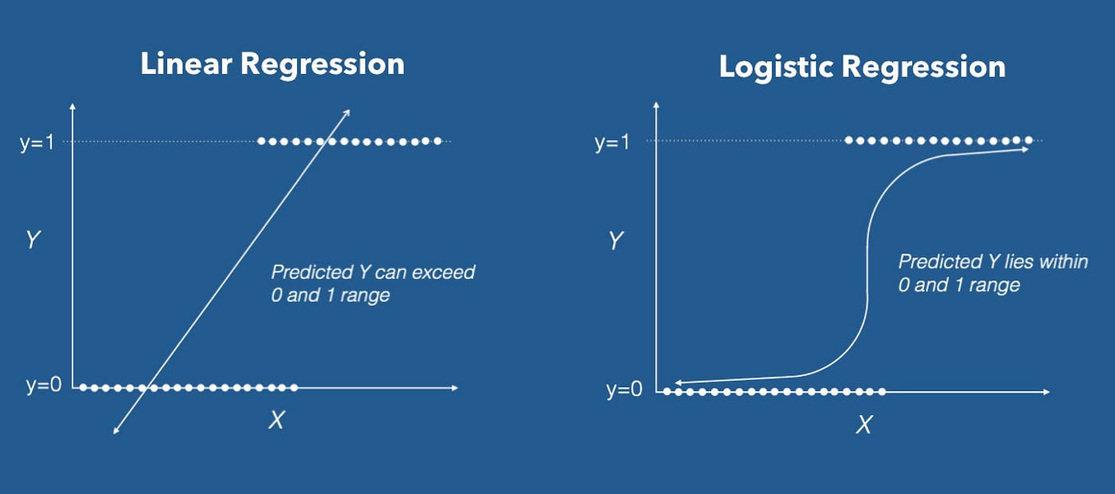
Logistic Regression vs Other Methods
Here, its cousin linear regression performs poorly. It has the ability to provide us with strange predictions outside of the 0–1 range, which defies probability logic.
Consider logistic regression to be the older, wiser sibling. It keeps things reasonable and ideal for probabilities by using a sigmoid function to map our predictions to a smooth curve.

Slide 6
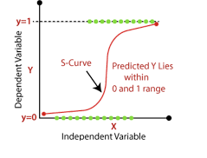
Components of Logistic Regression
- Dependent Variable
- Independent Variable
- Logistic Function

Slide 7
Logistic Regression Equation
Equation:
P(Y=1)=1/{1+e−(b0​+b1​X1​+b2​X2​+...+bn​Xn​)}​
- P(Y=1): Probability of the outcome being 1 (success).
- e: The mathematical constant (approximately 2.71828).
- (b_0, b_1, b_2, ... , b_n): Coefficients representing the impact of each predictor.
- (X_1, X_2, ... , X_n): The values of our independent variables.

Slide 8
Sample Scenario
Imagine a scenario where we want to predict if it rains today or not.
- Data Collection: I have gathered information of Temperature, humidity, wind.
- Model Training: Using logistic regression, we create a magical formula that links them to the probability of rainfall.
- Prediction: Now, for a new day, we can plug in these values into our formula and predict the probability of rain.
- Interpretation: If the predicted probability is, say, more than 0.5, we might predict yes, it will rain. If less, we might predict a no.

Slide 9
Regularization Methods
L1 Regularization:
By adding a penalty term to the logistic regression cost function, L1 regularization forces the model to retain only the most significant features by promoting sparse coefficients, which cause some coefficients to become exactly zero.
L2 Regularization:
In the case of L2 regularization, the sum of the squared values of the coefficients is added as a penalty term to the logistic regression cost function, which also penalizes large coefficients.

